Slide 1
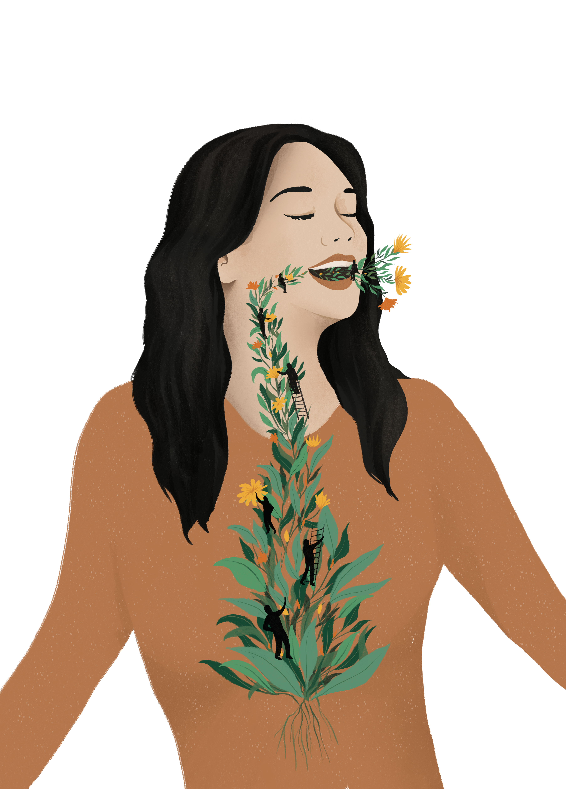

THE SINGER INSIDE OUT
Estill Voice World Symposium
2023 Vienna
Katrien Van Opstal
katrienvanopstal@gmail.com

Slide 2





ONLINE POLL:
Registrate on:

Slide 3

Research history
2018-2020 Style, sound and voice production in vocal jazz
2020-2021 Clarifying vocal jazz: from insight to practice
2021-2023 The Singer Inside Out
Royal Conservatoire of Antwerp, Belgium
Promotors Eugeen Schreurs and Hendrik Braeckman
Assisting: Vanessa Matthys
Advising: Barbara Wiernik, dr. Justin Binek, Dorte Hyldstrup, Stefania Patanè
Me =
Katrien Van Opstal
Jazz singer
Researcher at RCA, Antwerp, Belgium
Teacher at RCA, Antwerp, Belgium
Teacher at Kunstenacademie, Waregem, Belgium
Estill Master Trainer

Slide 4
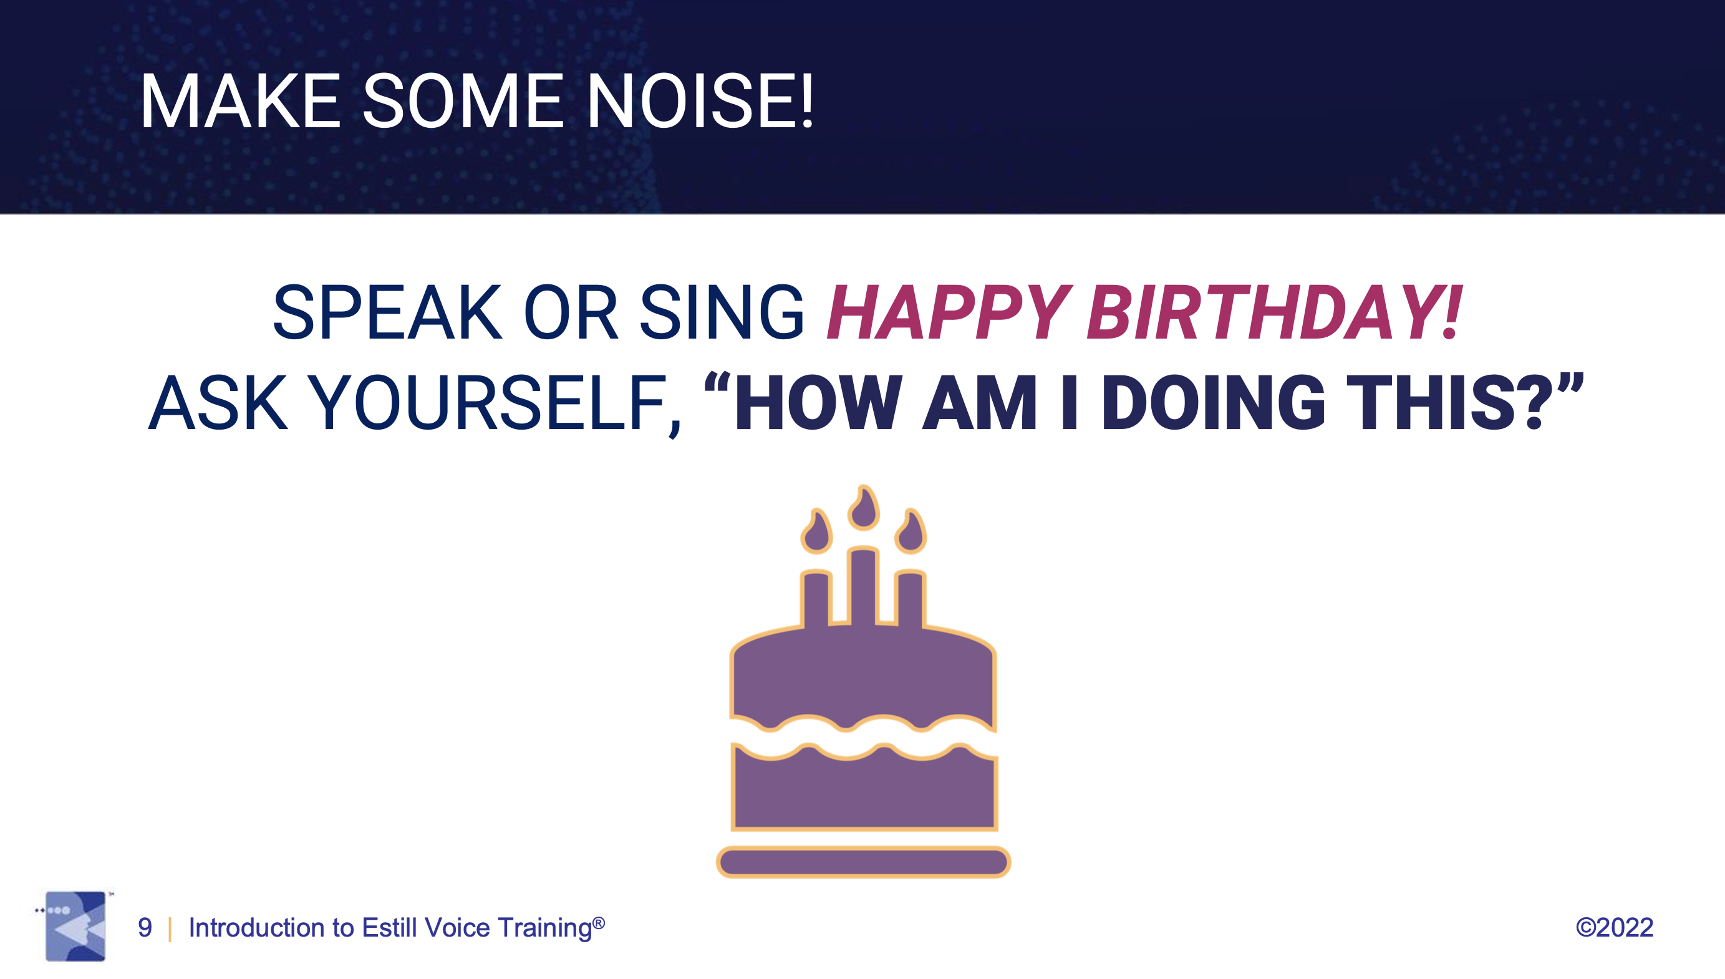

Slide 5
HOW AM I DOING THIS?
HOW AM I FEELING?

Slide 6
FALSE VOCAL FOLDS CONSTRICTED
FEELS LIKE….
PERCEIVED LIKE….
Anger, fear, overexcitement, stress, suppression of sadness, uncomfortable
Tensed, flirtatious, swag, tough
FALSE VOCAL FOLDS MID
FEELS LIKE….
PERCEIVED LIKE….
Relaxed, naturally, at ease
Grounded, sincere, authentic
FALSE VOCAL FOLDS RETRACTED
FEELS LIKE….
PERCEIVED LIKE….
Free, happy, joy, relief, sadness, cry from happiness (fi after giving birth, silent joke, burst of joy, relief after sadness
Sweet, therapeutic, child-like, happy, formal, pretty, musical, pleasant

Slide 7
MORE FIGURES => WWW.KATRIENVANOPSTAL.COM
FROM OCT 2023
FALSE VOCAL FOLDS | Feels like | Sounds like
Constricted | Anger, fear, overexcitement, stress, suppression of sadness, uncomfortable | Tensed, flirtation, swag, tough
Mid/Relaxed | Relaxed, naturally, at ease | Grounded, sincere, authentic
Open | Free, happy, joy, relief, sadness, cry from happiness (fi after giving birth, silent joke, burst of joy, relief after sadness | Sweet, therapeutic, child-like, happy, formal, pretty, musical, pleasant
TRUE VOCAL FOLDS | Feels like | Sounds like
Thick | Conviction, comfortable, putting yourself out there
Thin | Sweet, caring, emotionally unstable, you might break down and cry, fragile, delicate
Stiff | Happy, overenthousiastic, fragile, plain (not a lot of emotion), sexy , soft Sexy, soft, fragile, plain
Slack |  | Seductive, swag
HEAD AND NECK | Feels like | Sounds like
Anchored | Strong, putting yourself out there | Intimidating, confident, grounded, f.i. David Lynx, present, believable
Relaxed | Relaxed, silently confident, grounded, approachable
Notes: | Hard one, this one gives away issues with power, control, fear… not so clear
LARYNX | Feels like | Sounds like
Low |  |  | Formal (news), soothing (Klara), dark, not pleasant, annoying, tiring, uninterested, distant, calm, therapeutic, grounded, safe, relaxing, comfortable, heavy, weighty
Mid
High |  |  | Irritating, without backbone, unstable, innocent, naughty, playful, teasing
AES | Feels like | Sounds like
Narrowed | Putting yourself out there |  | Clear, with authority, leading, catching attention, little intimidating, annoying
Wide |  |  | Calming, meditation voice, inoffensive, pleasant, effortless, boring
TORSO-ANCHORING | Feels like | Sounds like
On | Permission to make sound, open, free, hiding vulnerability, defensive |  | Confident, connected to body, down-to-earth, grounded, demanding, open, with authority, stable, defensive against vulnerability
Off | Comfortable |  | Non-demanding, asking
THYROID | Feels like | Sounds like
Vertical | Feels less like singing |  | Matter-of-fact, grounded, monotonous, not connected, fluent, natural, authentic
Tilted | Feels like legato |  | Sweet, chipper, beautiful, pleasant, floating

Slide 8
HOW AM I DOING THIS?
HOW AM I FEELING?
HOW AM I FEELING IN THIS SONG ?
HOW DO I FEEL THESE FEELINGS ?
HOW DO I CONNECT MY FEELINGS WITH MY VOICE ?

Slide 9

TOOL 1: 6 BASIC EMOTIONS
Cfr. Paul Ekman
JOY SADNESS
ANGER FEAR
SURPRISE DISGUST

Slide 10
TOOL 2: MORE NUANCES in EMOTIONS
Source: Nonviolent communication, Marshall B Rosenberg, PhD
FEELINGS WHEN NEEDS ARE FULFILLED
Amazed Fulfilled Joyous Stimulated
Comfortable Glad Moved Surprised
Confident Hopeful Optimistic Thankful
Eager Inspired Proud Touched
Energetic Intrigued Relieved Trustful
FEELINGS WHEN NEEDS ARE NOT FULFILLED
Angry Discouraged Hopeless Overwhelmed
Annoyed Distressed Impatient Puzzled
Concerned Embarrassed Irritated Reluctant
Confused Frustrated Lonely Sad
Disappointed Helpless Nervous Uncomfortable

Slide 11
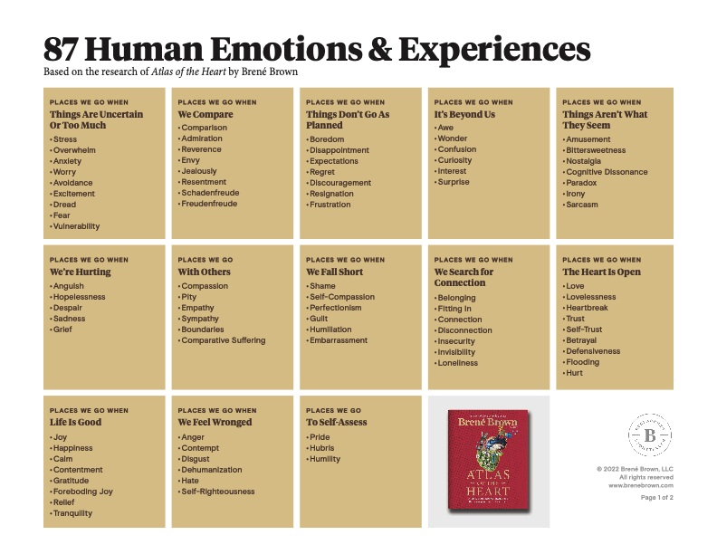
TOOL 3: DIGGING EVEN DEEPER
From ”Atlas of the Heart” by Brene Brown

Slide 12
You don't know what love is
Until you've learned the meaning of the blues
Until you've loved a love you had to loose
You don't know what love is
You don't know how lips hurt
Until you've kissed and had to pay the cost
Until you've flipped you're heart and you have lost
You don't know what love is
Do you know how a lost heart fears
The thought of reminiscing
And how lips have taste of tears
Loose the taste for kissing
You don't know how hearts burn
For love that cannot live, yet never dies
Until you've faced each dawn with sleepless eyes
You don't know what love is

Slide 13
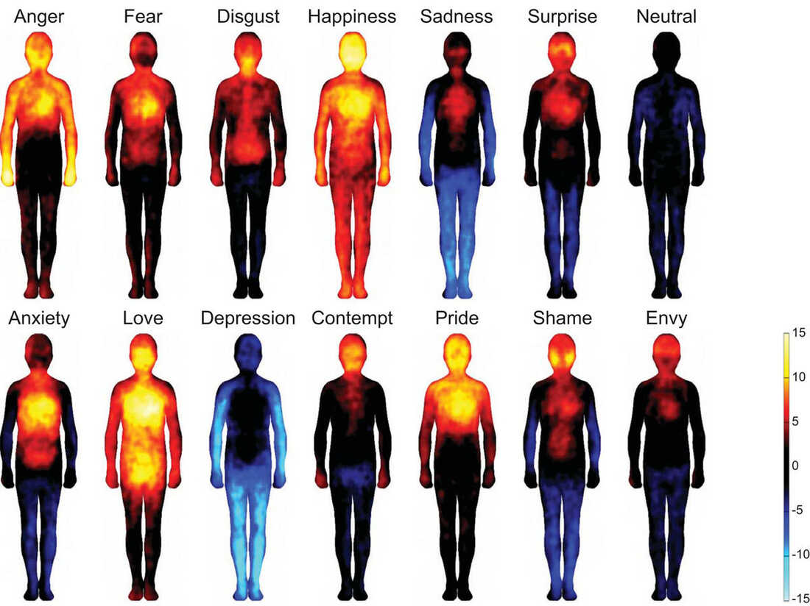
TOOL 4: GOING KINESTHETIC
Source: Image courtesy of Lauri Nummenmaa, Enrico Glerean, Riitta Hari, and Jari Hietanen. https://www.npr.org/sections/health-shots/2013/12/30/258313116/mapping-emotions-on-the-body-love-makes-us-warm-all-over

Slide 14
HOW AM I DOING THIS?
HOW AM I FEELING?
HOW AM I FEELING IN THIS SONG ?
HOW DO I FEEL THESE FEELINGS ?
HOW DO I CONNECT MY FEELINGS WITH MY VOICE ?

Slide 15
FROM EMOTIONS TO THE ESTILL FIGURES
Based on
Recordings in the class “The singer Inside Out, RCA, 2021-2022
Images of laryngostroboscopy at AZ Sint-Jan, 15/06/23

Slide 16
ONLINE POLL:
Registrate on:

Slide 17
ASPIRATE
RETRACT
STIFF
TILTED
NARROW
HIGH
ANCHORED
TILTED
= sound
SMOOTH
MID
THIN
MID
= image
GLOTTAL
WIDE
RELAXED
VERTICAL
CONSTRICT
THICK
VERTICAL
HIGH
LOW
False
Vocal Folds
True
Vocal Folds
Thyroid
Cartilage
AES
On- and
Offsets
On and
off-sets
Larynx
Torso
Cricoid
Katrien
Van Opstal

Slide 18
ASPIRATE
RETRACT
STIFF
TILTED
NARROW
HIGH
ANCHORED
TILTED
= sound
SMOOTH
MID
THIN
MID
= image
GLOTTAL
WIDE
RELAXED
VERTICAL
CONSTRICT
THICK
VERTICAL
HIGH
LOW
False
Vocal Folds
True
Vocal Folds
Thyroid
Cartilage
AES
On- and
Offsets
On and
off-sets
Larynx
Torso
Cricoid
Katrien
Van Opstal
* Sometimes irregular closure of TVF’s

Slide 19
ASPIRATE
RETRACT
STIFF
TILTED
NARROW
HIGH
ANCHORED
TILTED
= sound
SMOOTH
MID
THIN
MID
= image
GLOTTAL
WIDE
RELAXED
VERTICAL
CONSTRICT
THICK
VERTICAL
HIGH
LOW
False
Vocal Folds
True
Vocal Folds
Thyroid
Cartilage
AES
On- and
Offsets
On and
off-sets
Larynx
Torso
Cricoid
Katrien
Van Opstal

Slide 20
ASPIRATE
RETRACT
STIFF
TILTED
NARROW
HIGH
ANCHORED
TILTED
= sound
SMOOTH
MID
THIN
MID
= image
GLOTTAL
WIDE
RELAXED
VERTICAL
CONSTRICT
THICK
VERTICAL
HIGH
LOW
False
Vocal Folds
True
Vocal Folds
Thyroid
Cartilage
AES
On- and
Offsets
On and
off-sets
Larynx
Torso
Cricoid
Katrien
Van Opstal

Slide 21
ASPIRATE
RETRACT
STIFF
TILTED
NARROW
HIGH
ANCHORED
TILTED
= sound
SMOOTH
MID
THIN
MID
= image
GLOTTAL
WIDE
RELAXED
VERTICAL
CONSTRICT
THICK
VERTICAL
HIGH
LOW
False
Vocal Folds
True
Vocal Folds
Thyroid
Cartilage
AES
On- and
Offsets
On and
off-sets
Larynx
Torso
Cricoid
Katrien
Van Opstal
* With uncomplete closure of TVF’s (breathiness)

Slide 22
ASPIRATE
RETRACT
STIFF
TILTED
NARROW
HIGH
ANCHORED
TILTED
RAISED
= sound
SMOOTH
MID
THIN
MID
HIGH
= image
MID
LOW
GLOTTAL
WIDE
RELAXED
VERTICAL
CONSTRICT
THICK
VERTICAL
HIGH
LOW
False
Vocal Folds
True
Vocal Folds
Thyroid
Cartilage
AES
On- and
Offsets
Soft
Palate
On and
off-sets
Larynx
Torso
Cricoid
Katrien
Van Opstal

Slide 23
ASPIRATE
RETRACT
STIFF
TILTED
NARROW
HIGH
ANCHORED
TILTED
= sound
SMOOTH
MID
THIN
MID
= image
GLOTTAL
WIDE
RELAXED
VERTICAL
CONSTRICT
THICK
VERTICAL
HIGH
LOW
False
Vocal Folds
True
Vocal Folds
Thyroid
Cartilage
AES
On- and
Offsets
On and
off-sets
Larynx
Torso
Cricoid
Katrien
Van Opstal

Slide 24
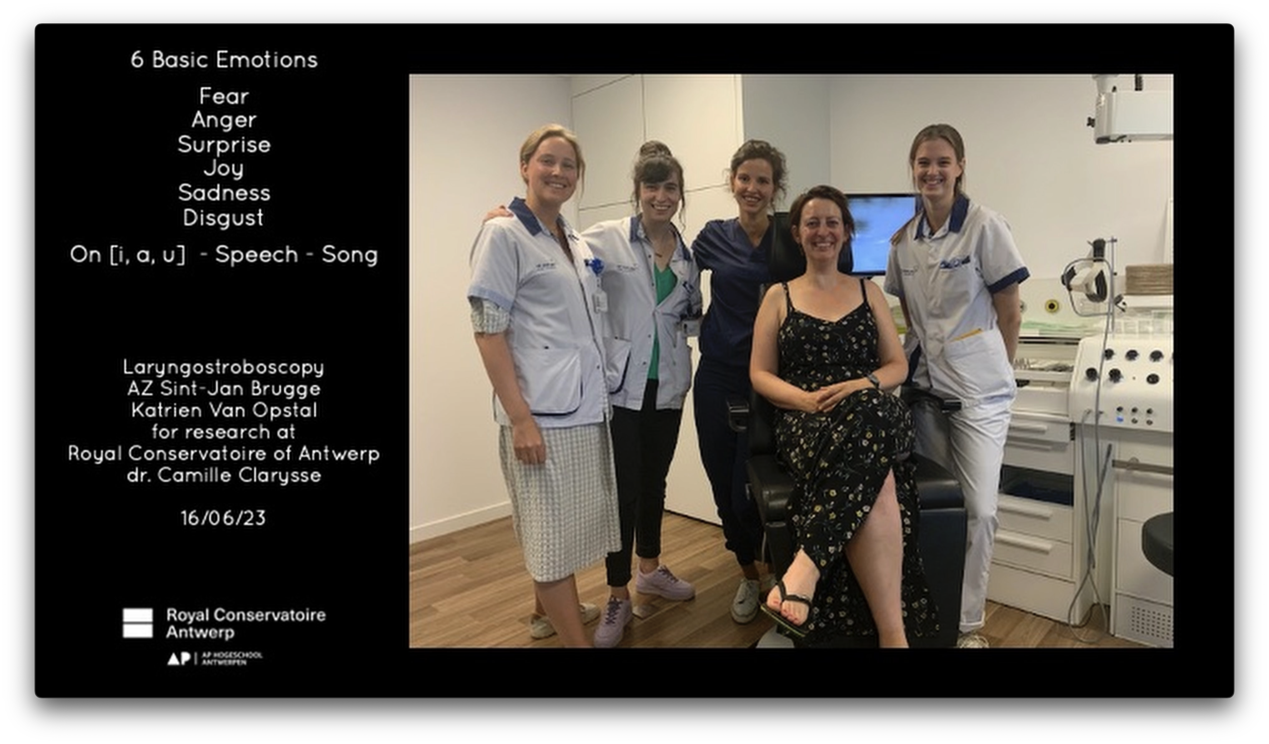
FROM EMOTIONS TO THE FIGURES
Full video on www.katrienvanopstal.com

Slide 25
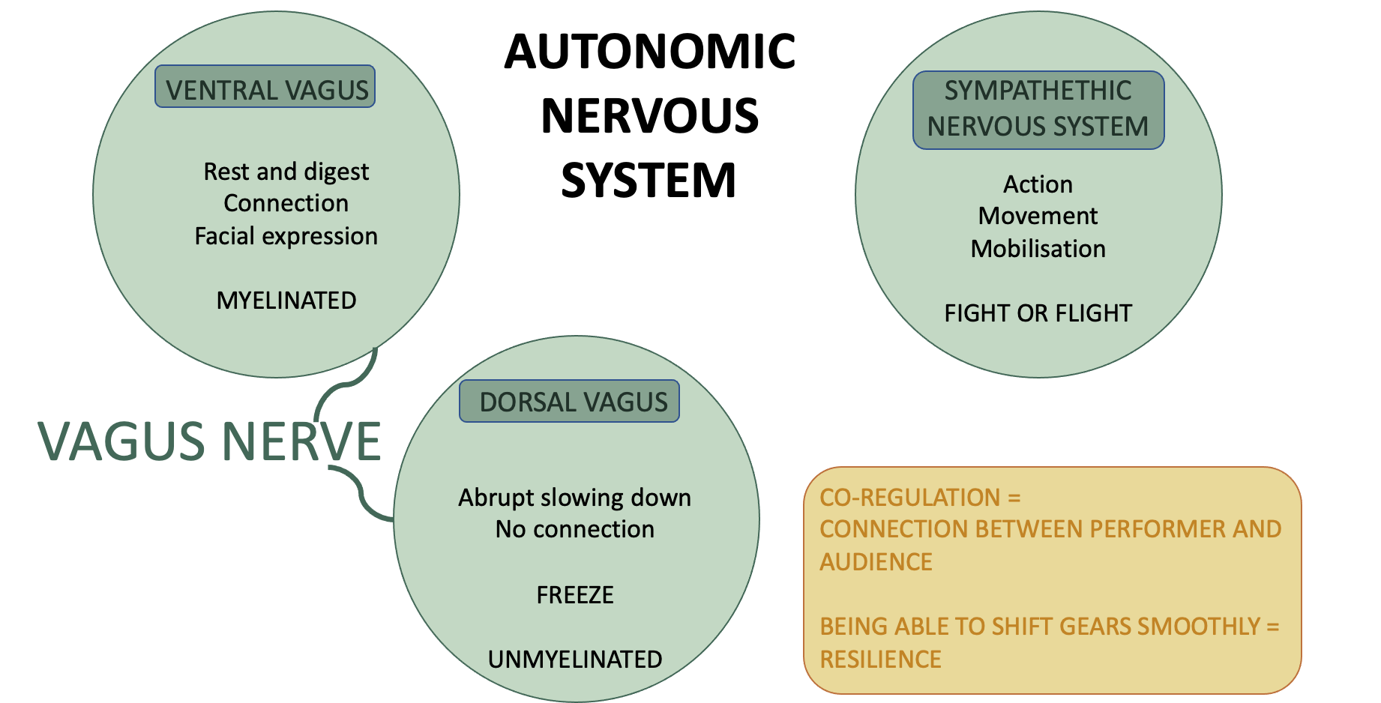
HOW TO STAY CENTERED: POLYVAGAL THEORY

Slide 26
CRAFT
-the voice-
MUSICALITY
-the music-
Harmony
Rhythm
Phrasing
…
MAGIC
INTENTION
-heart and soul-

Slide 27
TESTIMONIALS
It made me realize again that I love to sing. You have to enjoy the moment and just let it come.
I had more empathy and love for my body. It is a strong cooperation but not only on a technical level. If you experience something positive or negative you experience it with your whole body.
I am much more aware of the differences between emotions and how it translates into my body. I am more aware of my posture and how my body is part of my instrument. The connection between body and voice is better.
I release my emotions more and use them as art or message to others. I hope that people are then touched in their own way with their emotions or can recognize themselves sometimes.
My voice uses certain technique more in function of the story itself now instead of having to choose it. When I am angry, for example, it is louder. Playful is with more air.

Slide 28
Thank you!
All of you!
Estill voice Training
Royal Conservatoire of Antwerp
Vanessa Matthys and dr. Justin Binek
My advisors, promotors and everyone whose brain i could pick
Questions?
Contact:
Katrienvanopstal@gmail.com
Facebook
www.katrienvanopstal.com

